Slide 1
Overview of GUI Programming
BY
Rupali Pawar

Slide 2
.NET Framework
The . NET framework is a software development framework from Microsoft
It is a virtual machine for compiling and executing programs written in different languages like C#, VB.Net etc.
NET framework is an execution and development platform for building applications for windows,windows phone,windows server,windows azure.
Ex:Desktop Applications( windows, console application),Mobile based applications, Web applications

Slide 3
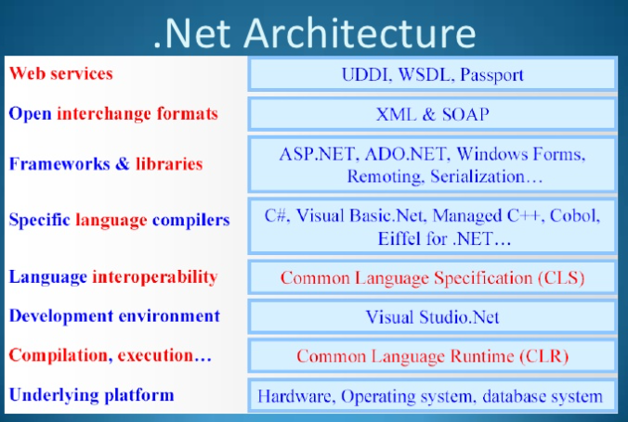

Slide 4
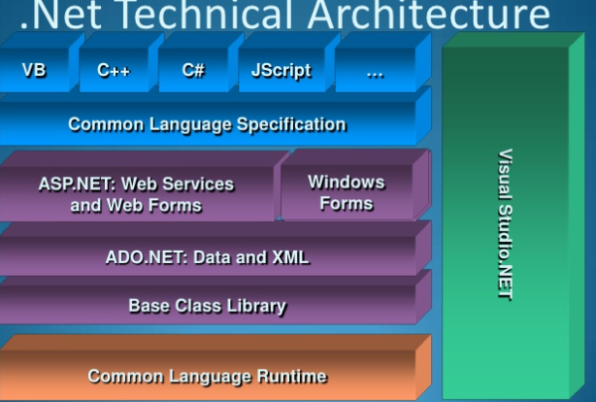

Slide 5
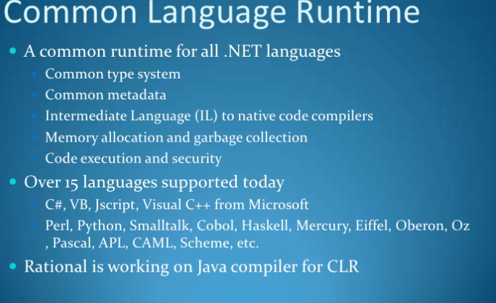

Slide 6
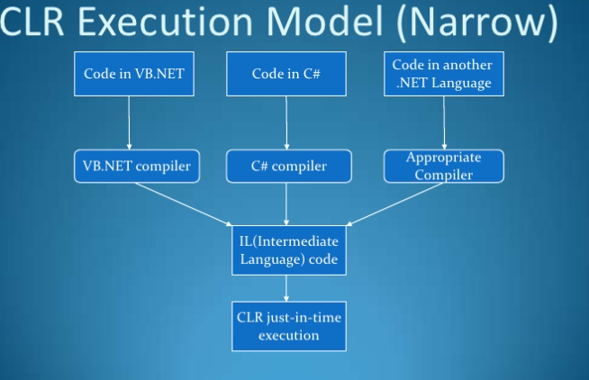

Slide 7
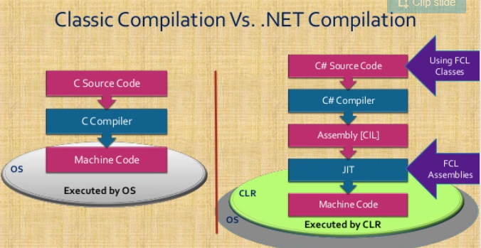

Slide 8
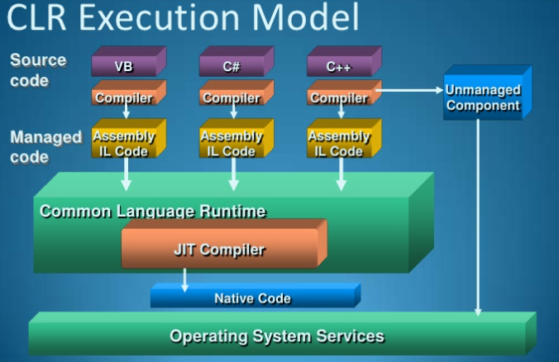

Slide 9
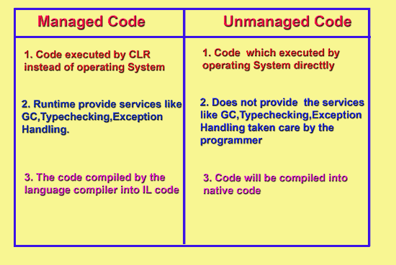

Slide 10
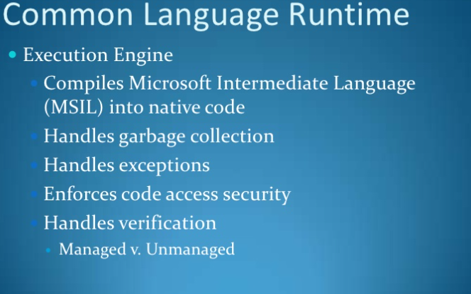

Slide 11
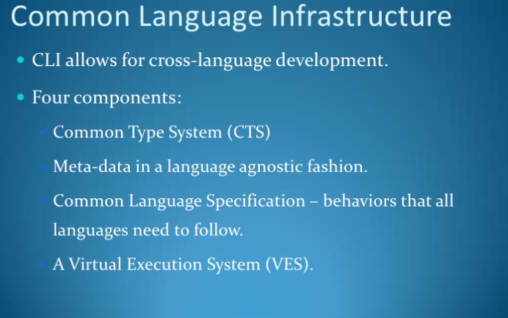

Slide 12
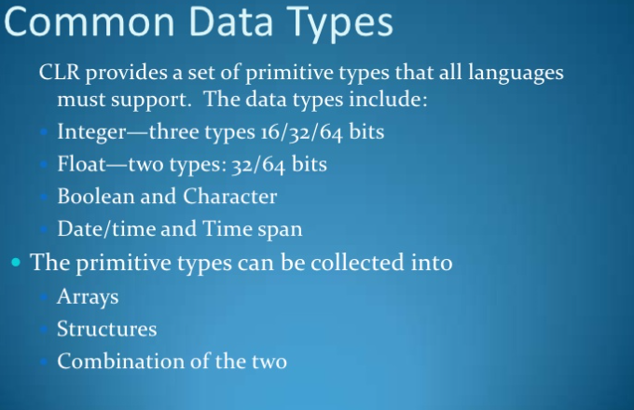

Slide 13
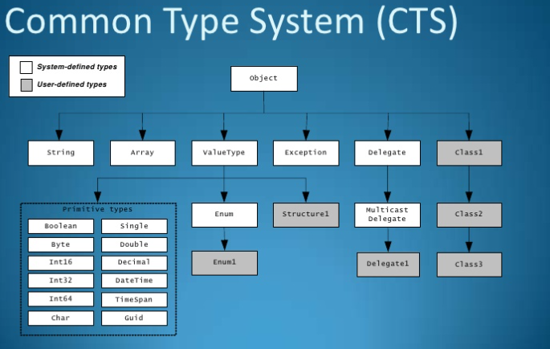

Slide 14
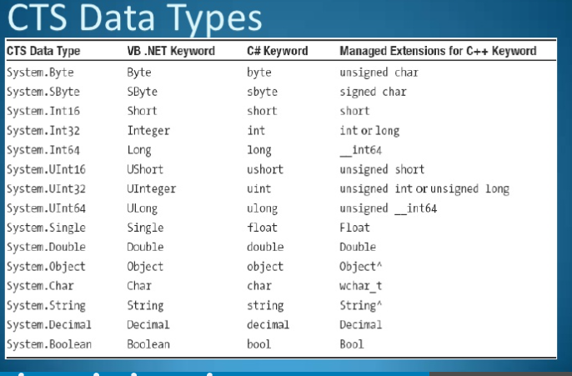

Slide 15
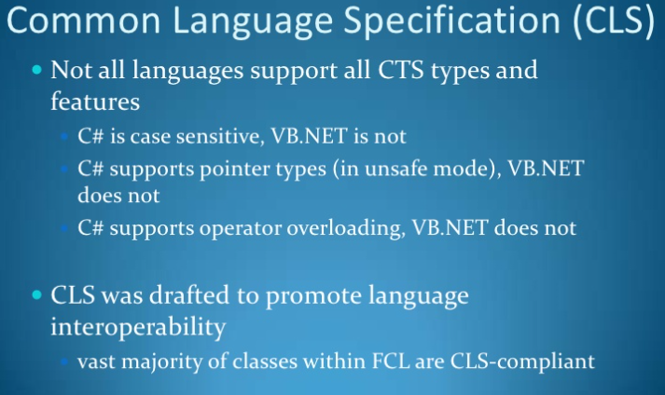

Slide 17
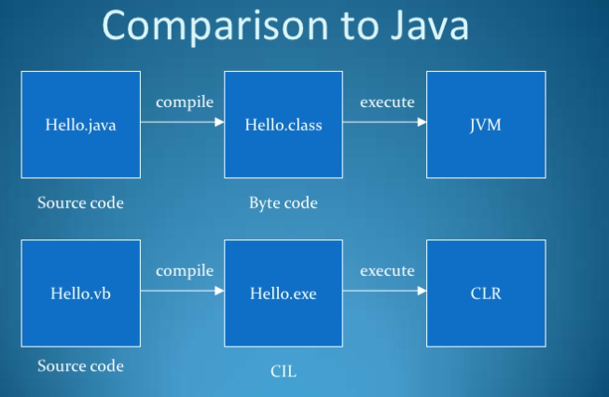

Slide 18
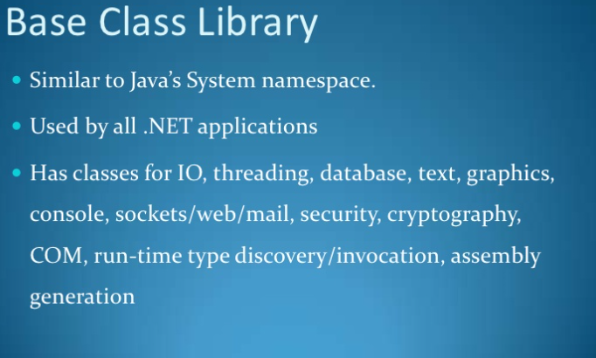

Slide 20
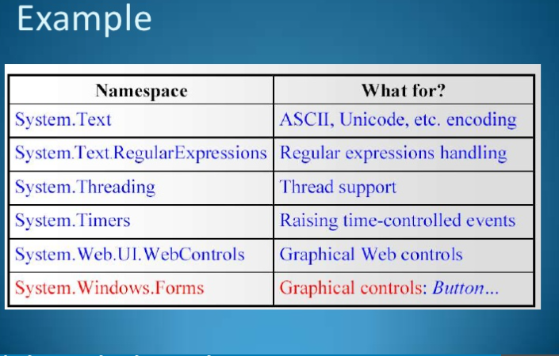

Slide 21
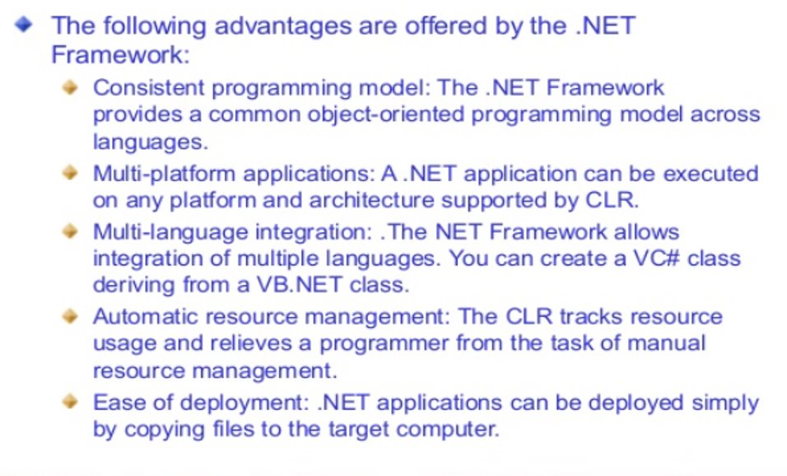

Slide 22
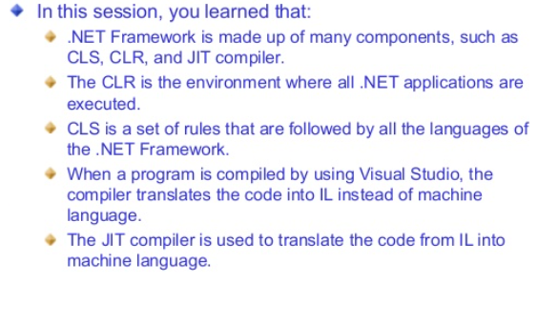

Slide 23
Microsoft Visual Studio
An Integrated Development Environment
IDE is a software application that provides comprehensive facilities to computer programmers for software development.
IDE consists of a source code editor,build automation tools and a debugger.

Slide 24
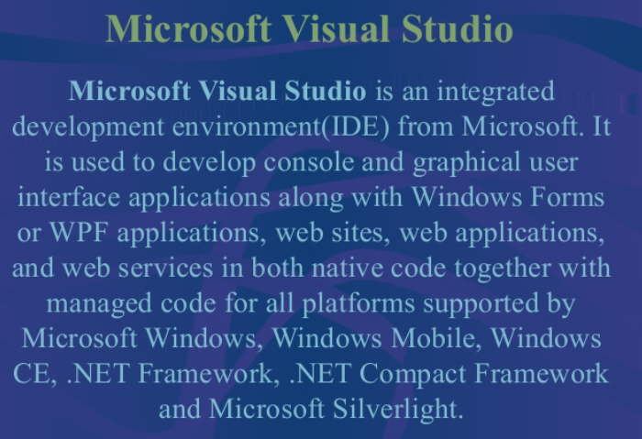

Slide 25
Graphical User interface
An interface is a layer between user and an application.it helps the user to interact with the application.
There are two types of user interfaces
1.Character user interface(CUI)-text based interface
2.Graphical user interface(GUI)-graphical components

Slide 26
Advantages of GUI
They are easy to learn and use.
Users need not remember the lines of syntax
Commands are executed by using mouse
GUI application interacts with the users through various components,called controls.

Slide 27
Features of windows environment
-Enable applications to interact effectively with the users are:
1.Event-driven Programming.
2.Dyanmic linking

